Slide 1
Predictive Modelling

Slide 2
DATA EXPLORATION
Exploring data sets and developing deep understanding about the data is one of the most important skill every data scientist should possess. People estimate that time spent on these activities can go as high as 80% of the project time in some cases – Read and observed.
Objective :
We have an objective to create a predictive model which predicts the total number of retweets a tweet will get using only the provided dataset.
Input Data:
We have an input data of Tweets with the given count of Retweet for every tweet happened in a day. So many attributes are associated with the data, which explains the behaviour and pattern the data has. Let’s go ahead with the underlined process of exploring it more and getting near to the objective.

Slide 3
DATA.DESCRIBE ()
 | TweetID | TweetInReplyToStatusID | TweetInReplyToUserID | TweetRetweetCount | TweetFavoritesCount | TweetPlaceAttributes | TweetPlaceContainedWithin | UserID | UserFollowersCount | UserFriendsCount | UserListedCount | UserTweetCount
Count | 4.24E+04 | 1.01E+02 | 1.89E+02 | 42368 | 42368 | 0 | 0 | 4.24E+04 | 4.24E+04 | 42368 | 42368 | 4.24E+04
Mean | 8.11E+17 | 8.11E+17 | 6.49E+16 | 1081 | 0.80 | NaN | NaN | 3.40E+17 | 6.20E+03 | 3859 | 312 | 3.78E+04
Std | 4.41E+13 | 2.58E+15 | 2.14E+17 | 1432 | 37 | NaN | NaN | 3.80E+17 | 5.62E+04 | 19345 | 850 | 9.00E+04
Min | 8.11E+17 | 7.86E+17 | 3.39E+06 | 0 | 0 | NaN | NaN | 1.97E+03 | 0.00E+00 | 0 | 0 | 1.00E+00
25% | 8.11E+17 | 8.11E+17 | 7.27E+07 | 0 | 0 | NaN | NaN | 5.86E+08 | 4.00E+01 | 40 | 17 | 2.79E+03
50% | 8.11E+17 | 8.11E+17 | 3.66E+08 | 14 | 0 | NaN | NaN | 4.61E+09 | 1.49E+02 | 304 | 41 | 1.99E+04
75% | 8.11E+17 | 8.11E+17 | 2.62E+09 | 3069 | 0 | NaN | NaN | 7.66E+17 | 1.82E+03 | 1780 | 217 | 3.33E+04
Max | 8.11E+17 | 8.11E+17 | 8.02E+17 | 4056 | 2813 | NaN | NaN | 8.11E+17 | 4.57E+06 | 689302 | 26577 | 2.06E+06
These are the fields which are present in the input data*. This describes the property of every numerical column (which can be summarized) present in the data. some column shows the count of the data as ‘0’, which neglects them from being the part of the dataset which we will analyze. This Table is giving us a summary of the data attributes. Now we have an idea of, amount of the data (Count), variation in the data (Min and Max) etc. so, we can go in details per column to approve the above properties.

Slide 4
DATA CLASSIFICATION : (Numerical and Categorical Data)
Numerical Columns
Index(['TweetID', 'TweetRetweetFlag', 'TweetInReplyToStatusID',
'TweetInReplyToUserID', 'TweetRetweetCount', 'TweetFavoritesCount',
'TweetPlaceAttributes', 'TweetPlaceContainedWithin', 'UserID',
'UserFollowersCount', 'UserFriendsCount', 'UserListedCount',
'UserTweetCount', 'MacroIterationNumber'],
dtype='object')
Categorical Columns
['TweetSource', 'TweetPostedTime', 'UserExpandedLink', 'TweetPlaceBoundingBox',
'TweetInReplyToScreenName', 'UserScreenName', 'TweetBody', 'UserSignupDate', 'Us
erName', 'TweetPlaceName', 'UserDescription', 'UserLink', 'TweetCountry', 'Tweet
PlaceID', 'UserLocation', 'TweetPlaceFullName', 'TweetHashtags', 'tweet.place']
Some of the fields above are not looking very relevant to the model we are trying to create. We will explore about them later. We should first check for the columns with ‘NULL’ in it.

Slide 5
NULL DATA IDENTIFICATION
Columns | NullPercentage
TweetPostedTime | 0%
TweetID | 0%
TweetBody | 0%
TweetRetweetFlag | 0%
TweetSource | 0%
TweetInReplyToStatusID | 100%
TweetInReplyToUserID | 100%
TweetInReplyToScreenName | 100%
TweetRetweetCount | 0%
TweetFavoritesCount | 0%
TweetHashtags | 0%
TweetPlaceID | 98%
TweetPlaceName | 98%
TweetPlaceFullName | 98%
TweetCountry | 98%
TweetPlaceBoundingBox | 98%
TweetPlaceAttributes | 100%
TweetPlaceContainedWithin | 100%
UserID | 0%
UserName | 0%
UserScreenName | 0%
UserLocation | 38%
UserDescription | 10%
UserLink | 61%
UserExpandedLink | 61%
UserFollowersCount | 0%
UserFriendsCount | 0%
UserListedCount | 0%
UserSignupDate | 0%
UserTweetCount | 0%
MacroIterationNumber | 0%
tweet.place | 98%
Tweet Data has 32 columns, where 17 columns
Has no Null values in the it.
we can not have a data which has more than 50% are Null Values. We have 13 columns falling in this criteria.
We will have to drop these columns as they will not have the same behavior across the model because having ‘Null’ will lose the significance for that variable.
Although UserLocation has 38% of the values with ‘Null’ but we need this variable while creating the model as Location will be directly proportional to the trend of a tweet.

Slide 6
DATA TREATMENT (MISSING DATA TREATMENT):
We have identified the columns with NULL values in it. Now, we will remove these columns from our input file, identified Numeric columns and identified Categorical Columns.
>>> inputtweet_mo= inputtweet.drop(dropcolfinal, axis=1).dropna()
>>> numericcol_mo= list(set(numericcol)-set(dropcol['ColName']))
>>> Categorical_mo= list(set(categoricalcol)-set(dropcol['ColName']))
Now, coming to the rest of the columns where there are ‘null’ values, we will have to replace these values with Mean/Median (for Numerical Columns) and some char e.g ‘-9999’ (for Categorival columns). So , we are going to impute Mean and ‘-9999’ in place of ‘null’ values.
>>> inputtweet_mo[numericcol_mo] = inputtweet_mo[numericcol_mo].fillna(inputtweet_mo[numericcol_mo].mean(),inplace=True)
>>> inputtweet_mo[Categorical_mo] = inputtweet_mo[Categorical_mo].fillna(value = -9999)

Slide 7
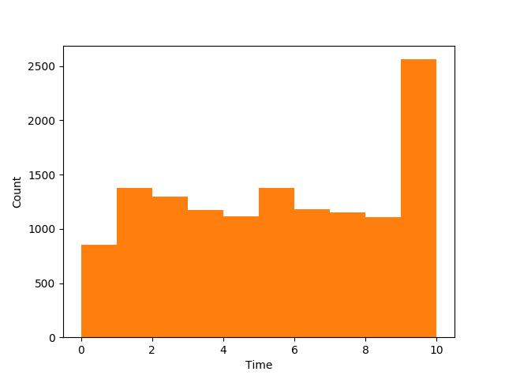
DATA TREATMENT Cont.….
Post analysis of the data, its been observed that the data is for a single date only with a different time stamp. We can use only Time (Hour, Minute and Second) to create the model
We will add three new columns named thour, tminute and tsecond in the input dataframe corresponding to the ‘TweetPostedTime ‘ column.
As you can see here that number of tweets been recorded at 10 ‘o’ clock is maximum.
Data has no record for the tweets after 10 ‘o’ clock.
At other times tweet count is following more or less the same trend.

Slide 8
DATA TREATMENT Cont.….
Some Columns like Userid, UserName, UserScreenName and Userdescription are redundant in nature which can be dropped since they do not potray any significance in relation to the predictive model
UserLink and UserExpandedLink should be dropped as well as they do not have a direct co-relation with the Target column (TweetRetweetCount)
PUNCTUATIONS & STOP WORDS
Columns like TweetBody, TweetHAshTags and UserLocation might have some punctuation and stop words which we want to ignore while applying our approach.
We have created functions to remove the punctuations, stopwords and remove ‘RT’ from the start of the Tweet.

Slide 9
TF-IDF : VECTORIZED INPUT
TweetBody, TweetHashtags and UserLocation are the fields which has very much significance with the objective of the problem.
Tweet Body : if body of two or more tweets are similar and number of times its been retweeted is also similar as well then we can find a correlation between them.
Tweet Hashtags: Hashtags is a trend for people who use twitter. Every theme or social message or an ongoing program can be identified by hashtag (E.g. Travel, food etc). This create a different segments for the data available.
User Location: A tweet for “Indian cricket team” victory will be retweeted in India mostly but if the tweet is for “England cricket Team” victory then retweet will happen in UK more.
APPROACH:
All the Columns mentioned above are of type String. The question is how can we analyze the similarity between every record in it
Text analysis states that we need to extract the features of a string in a numerical form so that we can measure the similarity
We will use TF (Term Frequency) and IDF (Inverse Document Frequency) to convert above columns into a vector form. Each row in these column will then be assigned according to the weight associated with it. These weights will be replaced with the original columns and then we will fit it into a model

Slide 10
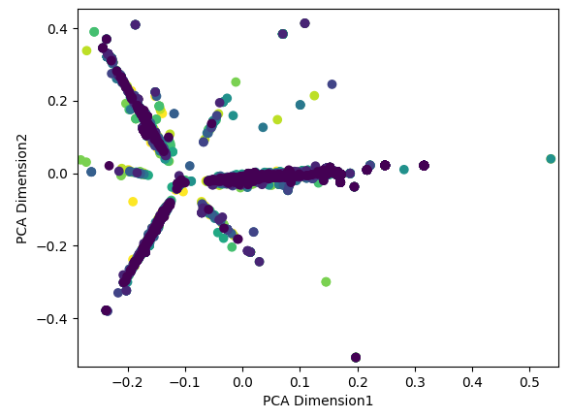
TF-IDF : VECTORIZED INPUT
While we convert the given columns to TF-IDF, we can always check the presentation of the vectors into a map
As the vector outcome will have multiple dimensions and if we need to draw it in 2-D we will have to apply PCA (Principal Component Analysis) to reduce the dimensions.
We will be using a Pipeline to merge the Two forms of models and get the desired results. We have used column “TweetHashtags” here
>>> pipeline = Pipeline([('vect', CountVectorizer()),('tfidf', TfidfTransformer()),])
>>> X = pipeline.fit_transform(inputtweet_mo.TweetHashtags).todense()
>>> pca = PCA(n_components=2).fit(X)
>>> D2 = pca.transform(X)
>>> plt.scatter(D2 [:,0], D2 [:,1],c=inputtweet_mo.thour )
>>> plt.xlabel('PCA Dimension1')
>>> plt.ylabel('PCA Dimension2')
>>> plt.show()

Slide 11
TF-IDF : VECTORIZED INPUT
In the last chart we have drawn ‘TweetHashtags’ ;colored with ‘thour’, which is a simple observation of hashtags. PCA helped to reduce the dimensions to two. Analyzing the chart we can see that hashtag behaviors are creating segments on their own. A similarity can be seen in the pattern of Hashtags.
Encoding : string Columns
We are now left with Numerical, Categorical and Vectorized input data
We now encode the categorical data to get the equivalent of numerical form
Numerical data will be left as it is.
Test and Train Data
Before we fit the data into a model, we need to divide the above data into two forms:
Train : Data which will build the model
Test : Data which will be test on that model

Slide 12
Random-Forest Model
Random forest Model is a Tree based model and;
“ Tree based learning algorithms are considered to be one of the best and mostly used supervised learning methods. Tree based methods empower predictive models with high accuracy, stability and ease of interpretation. Unlike linear models, they map non-linear relationships quite well. ”
In the given input dataset we have identified so many variables which has to be tested on their co-relationship with other variables. Random forest method fits right into this dataset as it can handle both numerical and categorical data.
We will try both Regressor and Classifier here while fitting the data into Random Forest Model.
The difference between both is:
one tries to create segment of the data and then predict the segment for the next data set
other one predicts the value of next data set on the basis of the data we fitted to create the model.
rf = RandomForestClassifier(n_estimators=300)
rf.fit(X_train,Y_train) ## fit the training data Set
rf.predict_proba(X_test) ## Predict Probability
rf.predict(X_test) ## Predict Values
rf = RandomForestRegressor(n_estimators=300)
rf.fit(X_train,Y_train) ## fit the training data Set
rf.predict_proba(X_test) ## Predict Probability
rf.predict(X_test) ## Predict Values

Slide 13
Random-Forest Model cont..
We have Created the Model and fitted it into the Train data which we had created.
We also tested and predicted values with the Test Data. Now we need the Estimator to check the Validity of the Model which has been created.
So We will Calculate R-squared Value of the model. To Calculate Score :
rf.score(X_test,Y_test) SCORE : 0.6662 ~ (67%)
We have created a model with R-Score Value 0.67 (67%), which is good.
We can still try to improve the performance of the Model by either reducing some inputs or transforming data for better modelling.

Slide 14
Thanks

